Slide 1
SUKANYA SAMRIDDHI YOJANA
JAIIB / CAIIB EXAMINATION
BANKING AWARENESS
Presented by Abinash Kr. Mandilwar
: Banking Digest by Abinash Mandilwar https://bankingdigests.com/

Slide 2
LAUNCHING & IMPLEMENTING AGENCY
Launching: Sukanya Samriddhi Yojana has been introduced vide Government of India Notification No. G.S.R.863(E) dated December 02, 2014 and circulated to Banks by Reserve Bank of India vide their letter No. RBI/2014-15/494/IDMD(DGBA) dated 11th March 2015.
Implementing Agency: Facility to open accounts under the scheme is available at all Banks and Post Office in India.
Objective: To promote the welfare of Girl Child.

Slide 3
ELIGIBILITY
Who can open the account: The account may be opened by the natural or legal guardian in the name of a girl child. Every beneficiary (girl) can have single account.
Age of girl child: Account can be open from the birth of the girl child till she attains the age of ten years.
KYC of the account: KYC documents (6 OVDs) of girl child including Aadhaar card & PAN card should be obtained at the time of account opening.
Maximum number of accounts: Up to two girl children or three in case of twin girls as second birth or the first birth itself results in three girl children.

Slide 4
DEPOSIT AMOUNT & TENURE OF THE ACCOUNT
Minimum and Maximum Amount of Deposit: Minimum Rs. 250 of initial deposit with multiple of Fifty Rupees thereafter with maximum annual ceiling of Rs.1,50,000/- in a financial year.
Tenure of the Account: 21 years from the date of opening of the account. No interest shall be payable once the accounts completes twenty-one years from the date of opening.
Maximum period up to which deposits can be made: Deposit may be made in the account till the completion of 15 years from the date of opening of a/c.

Slide 5
INTEREST AMOUNT
Interest rate notified by the Government from time to time, compounded yearly shall be credited to the account at the end of every financial year.
Interest will be calculated on lowest balance between 5th day & last day of the month.
No interest will be payable once the accounts completes twenty-one years from the date of opening.

Slide 6
Sukanya Samriddhi Yojana (SSY) Interest Rate Historical Data
Financial Year | Date | Interest Rate | Minimum Investment | Maximum Investment
2024-25 | 01-Apr-2024 to 30-Jun-2024 | 8.2% | ₹ 250 | ₹ 1,50,000
2023-24 | 01-Jan-2024 to 31-Mar-2024 | 8.2% | ₹ 250 | ₹ 1,50,000
2023-24 | 01-Apr-2023 to 31-Dec-2023 | 8.0% | ₹ 250 | ₹ 1,50,000
2022-23 | 01-Apr-2022 to 31-Mar-2023 | 7.6% | ₹ 250 | ₹ 1,50,000
2021-22 | 01-Apr-2022 to 31-Mar-2022 | 7.6% | ₹ 250 | ₹ 1,50,000
2020-21 | 01-Apr-2020 to 31-Mar-2021 | 7.6% | ₹ 250 | ₹ 1,50,000
2019-20 | 01-Jul-2019 to 31-Mar-2020 | 8.4% | ₹ 250 | ₹ 1,50,000
2019-20 | 01-Apr-2019 to 30-Jun-2019 | 8.5% | ₹ 250 | ₹ 1,50,000
2018-19 | 01-Oct-2018 to 31-Mar-2019 | 8.5% | ₹ 250 | ₹ 1,50,000
2018-19 | 01-Apr-2018 to 30-Sep-2018 | 8.1% | ₹ 250 | ₹ 1,50,000
2017-18 | 01-Jan-2018 to 31-Mar-2018 | 8.1% | ₹ 1,000 | ₹ 1,50,000
2017-18 | 01-Jul-2017 to 31-Dec-2017 | 8.3% | ₹ 1,000 | ₹ 1,50,000
2017-18 | 01-Apr-2017 to 30-Jun-2017 | 8.4% | ₹ 1,000 | ₹ 1,50,000
2016-17 | 01-Oct-2016 to 31-Mar-2017 | 8.5% | ₹ 1,000 | ₹ 1,50,000
2016-17 | 01-Apr-2016 to 30-Sep-2016 | 8.6% | ₹ 1,000 | ₹ 1,50,000
2015-16 | 01-Apr-2015 to 31-Mar-2016 | 9.2% | ₹ 1,000 | ₹ 1,50,000
2014-15 | 01-Apr-2014 to 31-Mar-2015 | 9.1% | ₹ 1,000 | ₹ 1,50,000

Slide 7
ACCOUNT OPERATION
Operation of account: It shall be a single account operated by guardian till the account holder attains the age of eighteen years.
In case the account holder wishes to operate the account after attaining the age of ten years, the same may be permitted.
However, deposit in the account may be made by the guardian.
Otherwise, account shall be operated by the beneficiary account holder after she attains the age of eighteen years.
Transfer of account: The account may be transferred anywhere in India if the girl child in whose name the account stands shifts to a place other than the city or locality where the account stands.

Slide 8
MATURITY, WITHDRAWAL AND CLOSURE
Maturity: The account remains operative for 21 years from opening or till marriage of the girl child after reaching the age of 18, whichever is earlier.
Irregular Payment/ Revival of account: By payment of penalty of Rs. 50 per year along with the minimum specified amount per year.
Premature Closure: Allowed in the event of death of the depositor or in cases of extreme compassionate grounds such as medical support in life threatening diseases to be authorized by an order by the Central Government.
Withdrawal : 50% of the balance lying in the account as at the end of previous financial year for the purpose of higher education, marriage after attaining the age of 18 years.

Slide 9
CALCULATION EXAMPLE OF SSY ACCOUNT DEPOSITS
The benefit of any investment can only be determined based on how much the investment grows over time. The following is a sample calculation showing the high returns you can get by making contributions to the Sukanya Samriddhi Yojana.
Let’s assume the following:
Annual investments = Rs. 1 lakh
Investment Period = 15 years
Total amount invested at the end of 15 years = Rs. 15 lakh
Value of Sukanya Samriddhi Investments at the end of 15 years assuming 8.50% per annum rate of interest = Rs. 30.63 lakh and after 21 years at the time of maturity, the total amount will be Rs. 49.98 lakh.
Thus, you can get more than triple your money by investing in this guaranteed return investment in the long term.

Slide 10
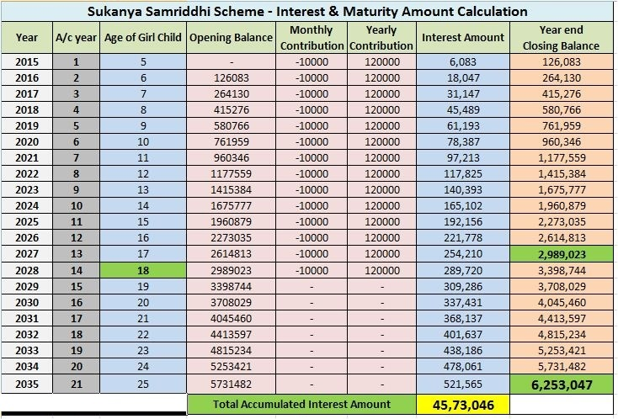

Slide 11
SUKANYA SAMRIDDHI YOJANA
NRI Status:
NRIs are not eligible to open these accounts.
A girl child is eligible for an SSY account only if she is a resident Indian citizen when the account is opened, and remains so until the maturity or the closure of account.
In case the beneficiary status changes to NRI, no interest will be paid from the date of NRI status and the account shall deemed to be closed prematurely from that date.
Tax Rebate:
From a taxation perspective, SSY investments are designated as an EEE (Exempt, Exempt, Exempt) investment.
This means that the principal invested, the interest earned as well as the maturity amount are tax free.
Under existing taxation rules of Sukanya Samriddhi Yojana, the tax deduction benefit on the principal amount invested is up to Rs 1.5 lakh per annum under Section 80C of the Income Tax Act, 1961.

Slide 12
As this is a Govt. of India scheme, customers are advised to visit, for latest instructions / modification in the scheme.
http://www.nsiindia.gov.in/writereaddata/FileUploads/SSA_GZT.pdf

